Slide 1

PLANT MONITORING SYSTEM
Group B-1
Eriqo Arief Wicaksono 2106638406
Juan Jonathan 2106704894
Muhammad Farrel Mirawan 2106731554
Rafi Fauzan Wirasena 2106656320

Slide 2
Problem Statement
It is difficult to identify when plants are experiencing issues related to their growing conditions.
Manual monitoring of plants also can be expensive and complex
​
Manual monitoring of plants can be time-consuming and may not always provide accurate data.
The current plant monitoring lack efficiency, accuracy, and real-time capabilities,

Slide 3
Proposed Solution
Efficient
Cost-Effective
Plant monitoring system using Arduino microcontroller R3, Includes 3 sensors, DHT11, YL38 and LDR
Improves plant health
User Friendly
Automated

Slide 4

Background
This project is designed to help people monitor the health of their plants by measuring various environmental factors such as soil moisture, surrounding environment temperature, and humidity of air using two sensors, YL39 and DHT11. 5 LEDs will act as indicators of environment quality that impact the plant ranging from healthy to critical.

Slide 5

Objective
The system must be able to monitor environmental factors that impact on the plant such as temperature, humidity, and soil moisture.
The system must be able to show the reading of the sensors using Max7219.
The system must be able to show the environmental quality using LEDs as indicators.
The system must be cost-effective and accurate.

Slide 6
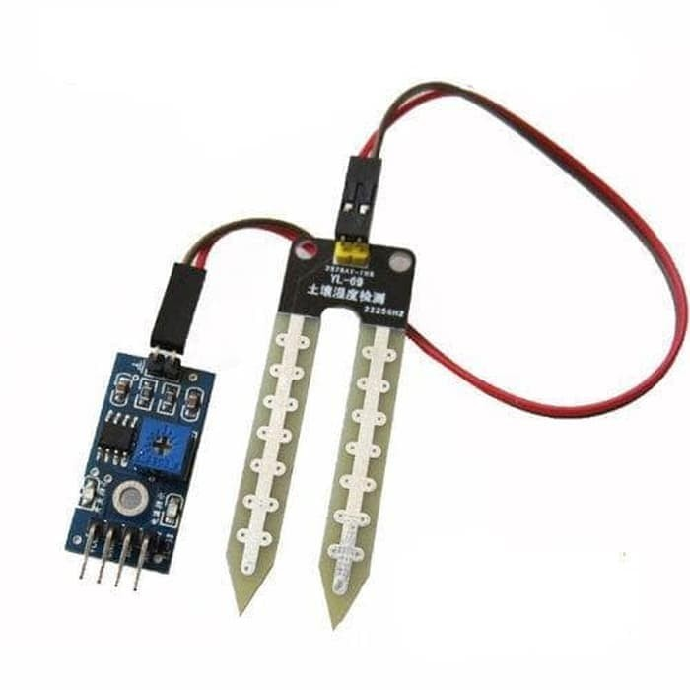
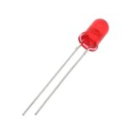
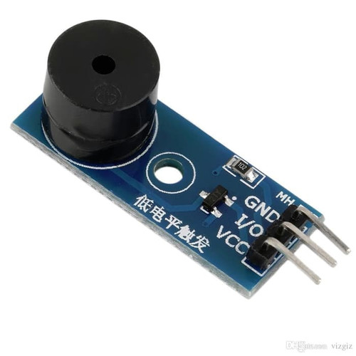
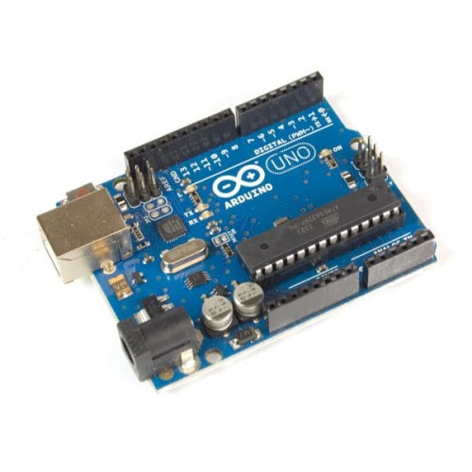
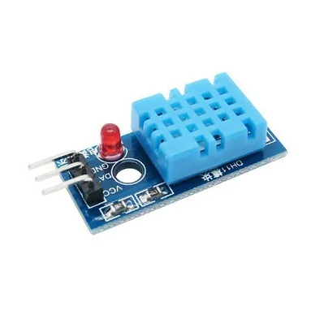
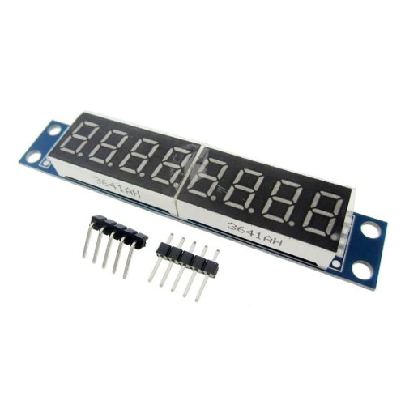
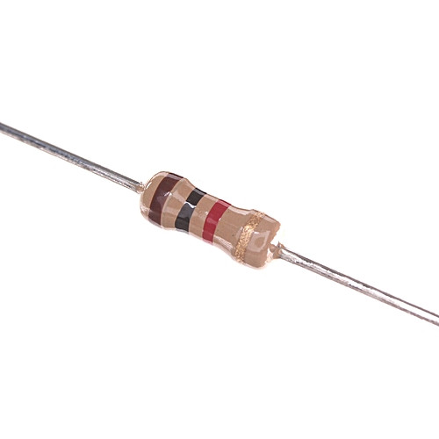
Component

Slide 7
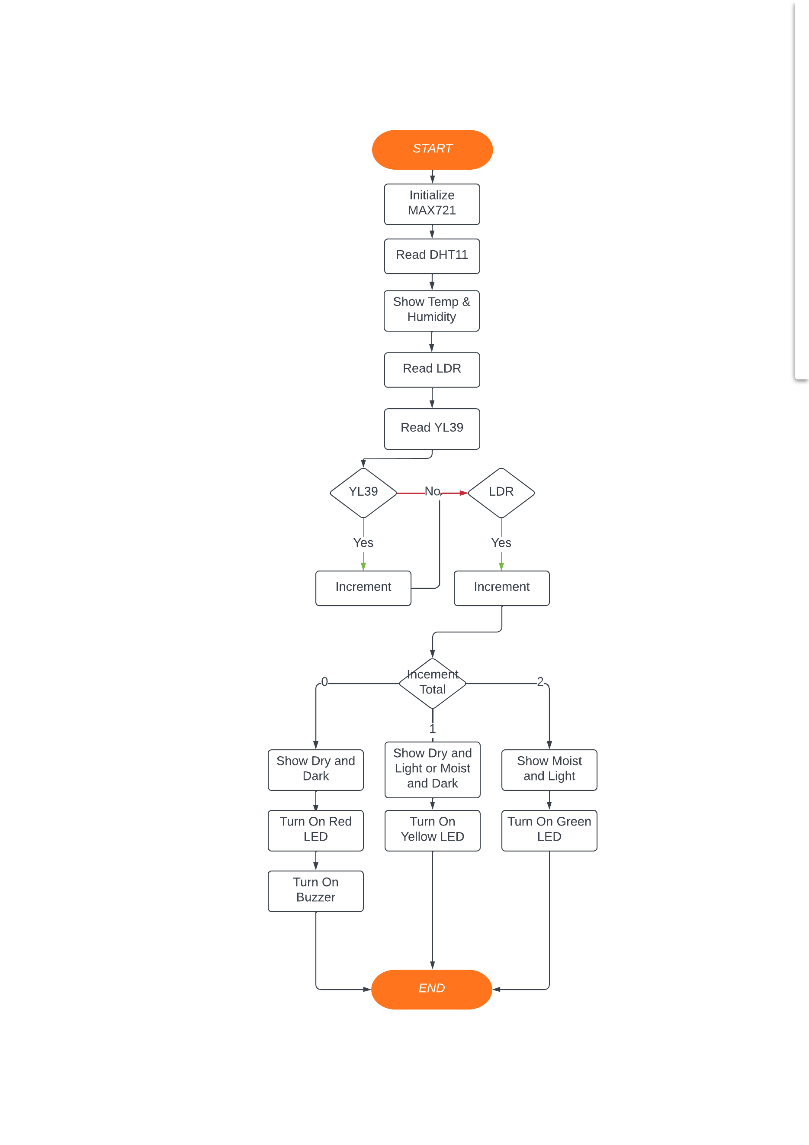
How it Works...?
Plant Monitoring System works by using 3 sensors that is :
YL38
DHT11
LDR
If the sensors detect factor that is bad for the plants such as minimal light and moisture then it will increment it's values. That values will be used to turn on the LEDs and buzzer

Slide 8
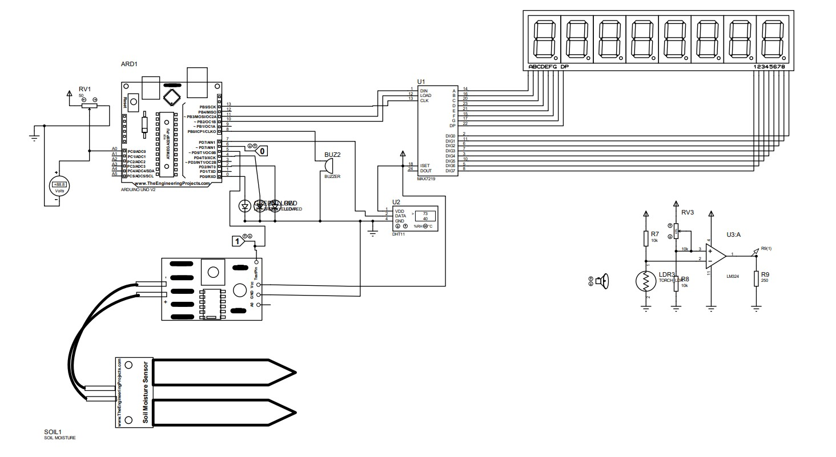
Hardware Schematics
The sensors will determine how the LED behave.
LED Status | LED 1 (Green) | LED 2 (Yellow) | LED3 (Red)
Moist/Terang | On | Off | Off
Moist/Gelap | Off | On | Off
Dry/Terang | Off | On | Off
Dry/Gelap | Off | Off | On

Slide 9
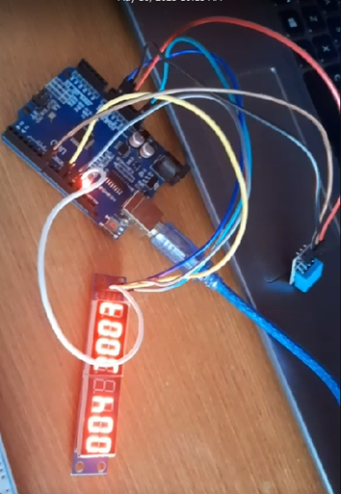
Testing & Result
Unit Testing
All individual components passed the unit testing phase successfully. The moisture sensor provided accurate moisture level readings, the temperature sensor measured the ambient temperature accurately, and the LCD display exhibited the correct output.

Slide 10
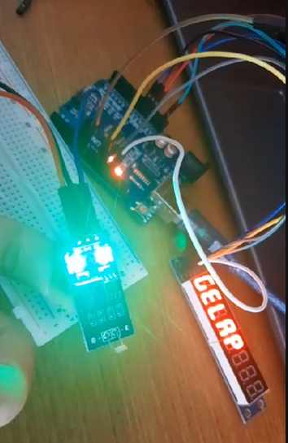
Testing & Result
Integration Testing
The integration testing phase verified that the components of the Plant Monitoring System were effectively integrated. Data flow between modules was smooth, and the system provided accurate and real-time readings of environmental parameters for multiple plants.

Slide 11
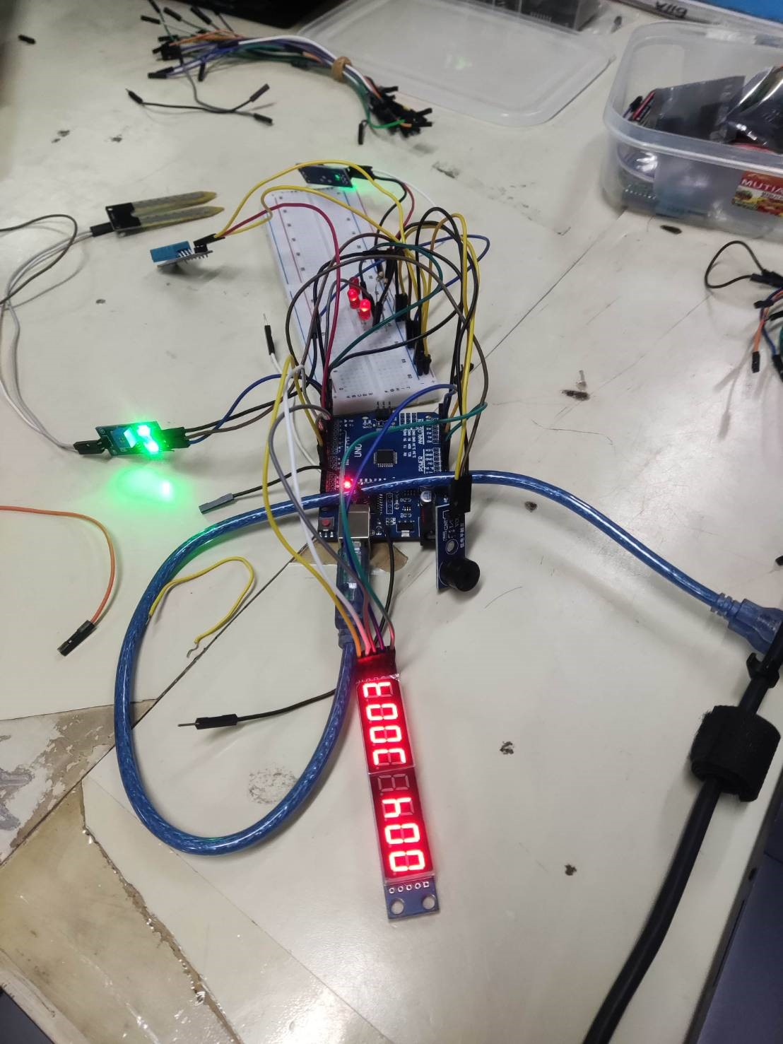
Testing & Result
User Acceptance Testing
User acceptance testing demonstrated that the system, when all the components are connected and used together in order to try it in the real-world environment has successfully outputted a correct reading of the environment temperature which was displayed on the MAX7219

Slide 12
Conclusion
Plant Monitoring System is an Arduino Uno project that is fully coded in Assembly Language and is used to monitor factors that impact the plants such as soil moisture level, light intensity, temperature and humidity using three sensors that is YL38, DHT11, and LDR.
This project is user friendly towards small farmers / gardeners because it’s cost efficient and easy to implement
Through this project we used and learn various hardware such as all the sensors and the Arduino itself, we first tried to make this project in Proteus in which it worked really well and according to what we wanted.

